Slide 1
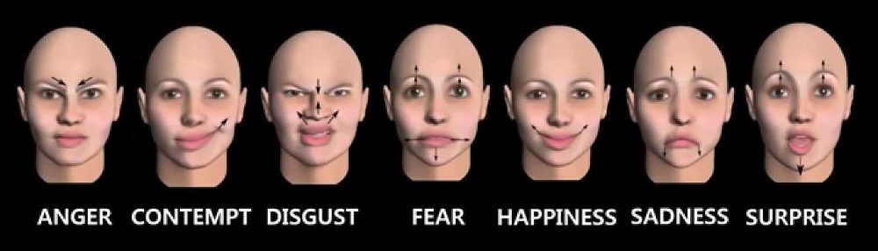
Facial Emotion Recognition
Emotions play an important role not only in our relations with other people but also in the way we use computers. Affective computing is a domain that focuses on user emotions while he or she interacts with computers and applications. As emotional state of a person may affect concentration, task solving and decision making skills, the vision of affective computing is to make systems able to recognize human emotions and influence them in order to enhance productivity and effectiveness of working with computers.

